Slide 1
Teaching Learning Strategies and Academic Language
Anna Uhl Chamot
Jill Robbins
Second Language Learning Consultants

Slide 2
WHAT IS ACADEMIC LANGUAGE?
Language used during teaching and learning.
Language of literature.
Language in content textbooks.
Language used to communicate new concepts.
Language of literacy.

Slide 3
Teaching Academic Language
Identify student needs
Provide comprehensible texts
Expect authentic and appropriate student products

Slide 4
ACADEMIC LANGUAGE NEEDS OF ENGLISH LEARNERS
Develop academic vocabulary.
Understand and use correct grammatical structures and appropriate discourse.
Read to acquire new information.
Understand information presented orally.
Participate in classroom discussions.
Write to communicate their knowledge and ideas.
Notes:
KEEP

Slide 5
ACADEMIC LANGUAGE TEXTS
Literature genres: stories, novels, poetry, biography.
Informational texts: articles, essays, textbooks.
Oral texts: teacher, speakers, students, video, TV, film, live performance.
Personal texts: journals, e-mails, instant messages, letters.
Notes:
KEEP

Slide 6
ACADEMIC LANGUAGE PRODUCTS
Book reports, essays, stories, poetry, biographies.
Science lab reports.
Math problem explanations.
Social Studies research reports.
Personal experience stories.
Constructed answers to demonstrate comprehension.

Slide 7
THE TEACHER’S ROLE
Model academic language.
Practice literacy across the curriculum.
Teach language awareness.
Develop students’ metacognition.
Teach learning strategies.

Slide 8
LANGUAGE AWARENESS AND USE
Focus on language forms.
Identify language registers.
Practice language functions.
Differentiate between discourse styles.
Use language for critical thinking.
Gain insight into own L1 and L2.

Slide 9
THINKING ABOUT THINKING:
A MODEL OF METACOGNITION
Declarative Knowledge:
Self Knowledge
World Knowledge
Task Knowledge
Strategy Knowledge
Procedural Knowledge:
Planning
Monitoring/ Identifying Problems
Evaluating

Slide 10
WHAT ARE LEARNING STRATEGIES?
Thoughts and actions that assist learning tasks.
Ways to understand, remember, and recall information.
Ways to practice skills efficiently.
Notes:
KEEP

Slide 11
WHAT DOES THE RESEARCH SAY?
All second language learners use strategies - BUT
“Good” language learners use more varied strategies and use them more flexibly.
Frequent use of learning strategies is correlated to higher self-efficacy.
Notes:
KEEP

Slide 12
MORE RESEARCH FINDINGS
Strategy instruction improves academic performance.
Instruction needs to be explicit.
Students need to develop metacognition.
Transfer is difficult.
Language of instruction matters.
Notes:
KEEP

Slide 13
LANGUAGE OF INSTRUCTION
Use native language if possible.
Name strategies in English.
Teach English vocabulary and structures needed to discuss strategies.
Be patient! Strategies take time!
Notes:
KEEP Ask ts who use Spanish to use NCLRC guides, or translate for their level

Slide 14
WHY TEACH LEARNING STRATEGIES?
Show students how to be better learners.
Build students’ self-efficacy.
Increase student motivation for learning.
Help students become reflective and critical thinkers.
Notes:
KEEP

Slide 15
TIPS ON TEACHING
LEARNING STRATEGIES
Build on students’ current learning strategies.
Demonstrate how to use the learning strategy by modeling.
Give the strategy a name.
Provide ample practice opportunities.
Notes:
KEEP

Slide 16
CALLA Model for Teaching Academic Language, Content, & Learning Strategies

Slide 17

Metacognitive Strategies
Planning
  Understand the task
  Organize materials
  Find resources
Notes:
JILL

Slide 18

Metacognitive Strategies
Monitoring:
While working on a task:
  Check your progress on the task.
  Check your comprehension as you use the language. Do you understand? If not, what is the problem?
  Check your production as you use the language. Are you making sense? If not, what is the problem?
Notes:
ANNA

Slide 19
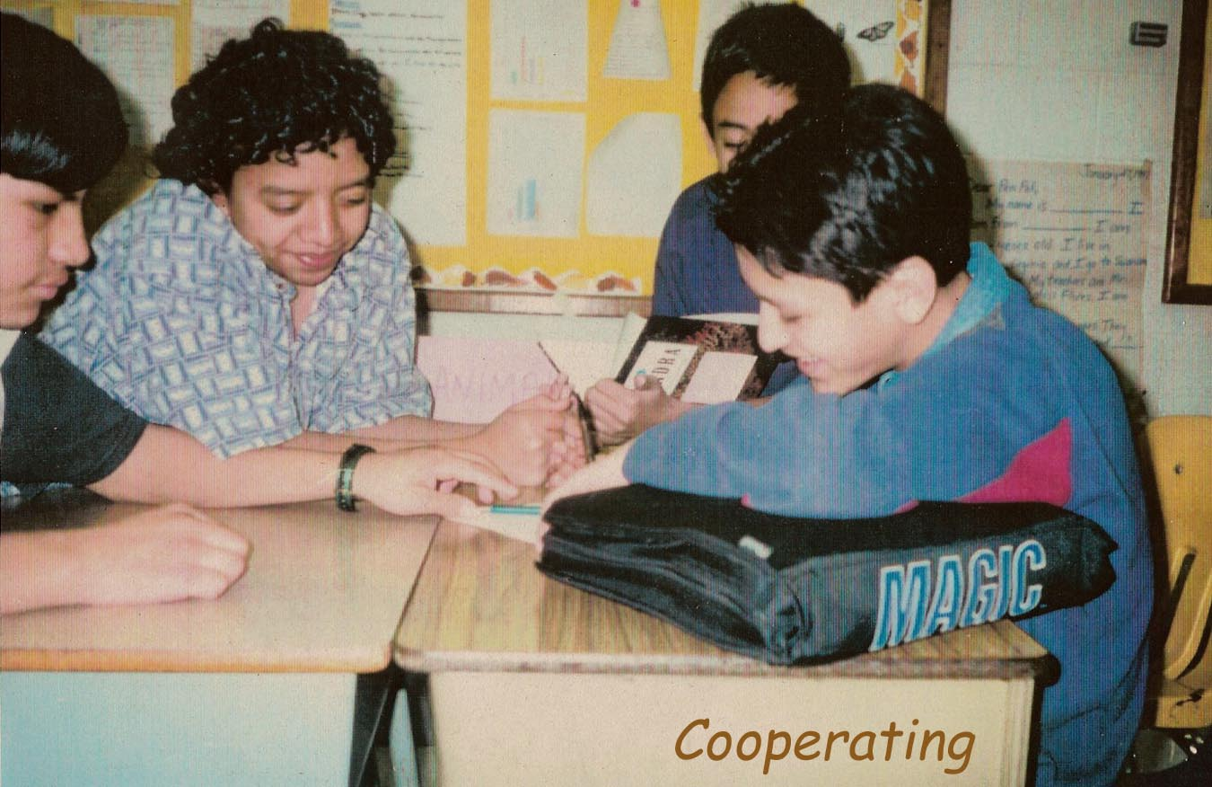
Social Learning Strategies
Cooperation: work with others to:
  complete tasks
  build confidence
  give and receive feedback
Notes:
Jill

Slide 20

Metacognitive Strategies
Evaluation: after completing a task:
  Assess how well you have accomplished the learning task.
  Assess how well you have used learning strategies.
  Decide how effective the strategies were.
  Identify changes you will make the next time you have a similar task to do.
Notes:
ANNA

Slide 21

Metacognitive Strategies
Self-Management: Manage Your Own Learning
  Determine how you learn best.
  Arrange conditions that help you learn.
  Seek opportunities for practice.
  Focus your attention on the task.
Notes:
Jill

Slide 22
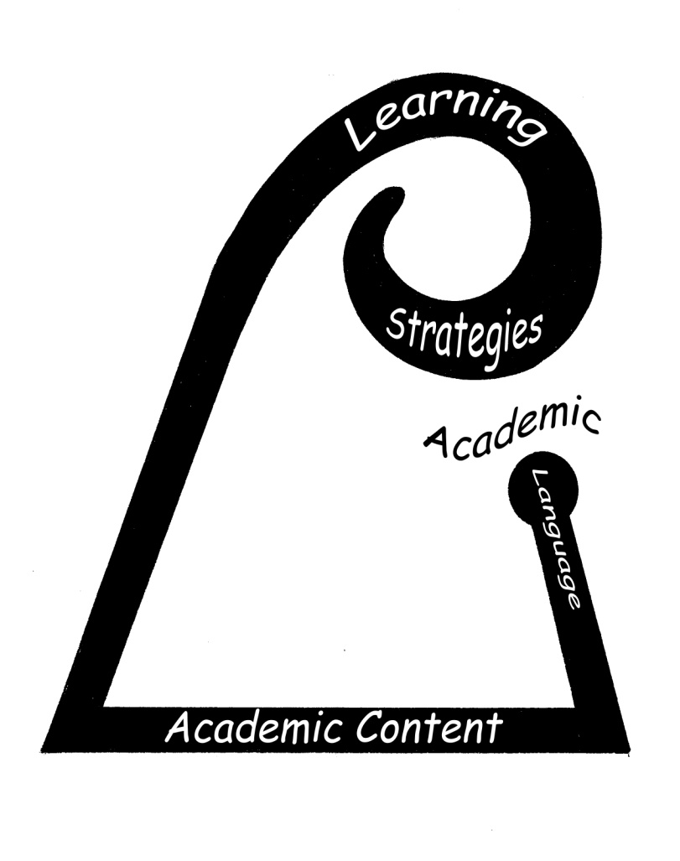
CALLA Instruction Is...
Learner-centered
Reflective
Supportive
Focused
Enthusiastic
Notes:
Anna:

